Slide 1
Analyse Shop Store
File created on: 19/01/2021

Slide 2
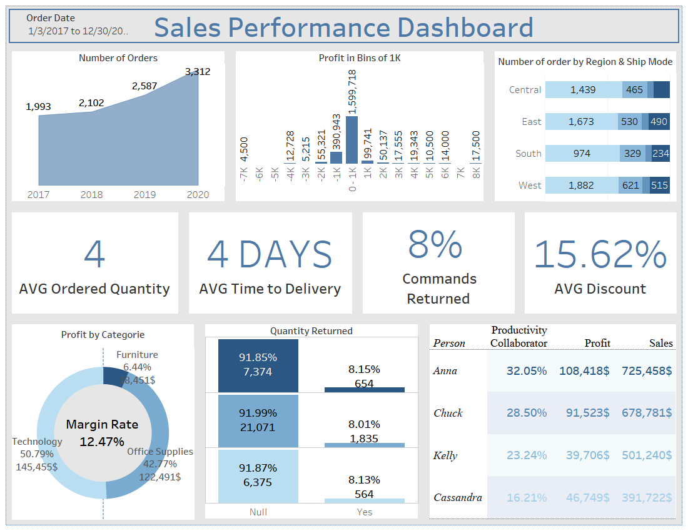

Slide 3
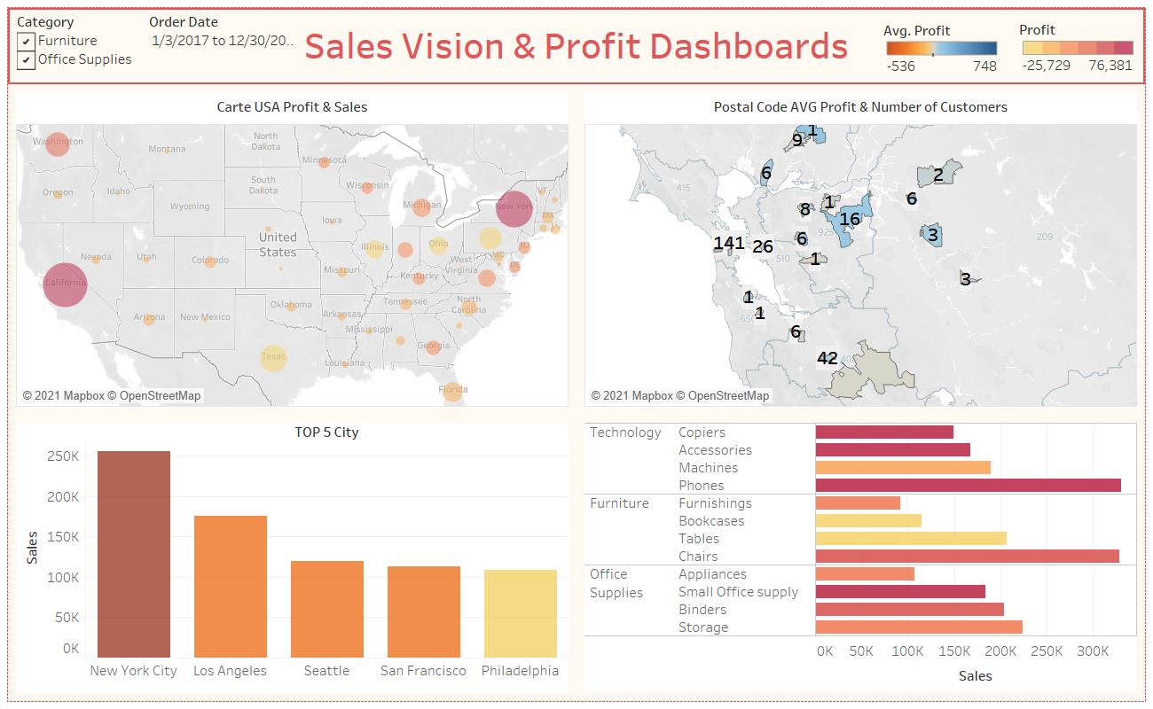

Slide 4
